Slide 1
What COVID-19 Means for Immigrants’ Sexual and Reproductive Health
Sheila Desai, Senior Research Scientist

Slide 2
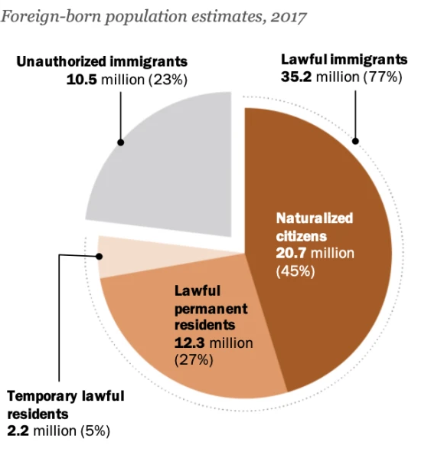
Who Are Immigrants in the United States?
14% of U.S. population
1 in 5 women of reproductive age (15–44 years old)
1 in 4 births among immigrants
Heterogeneous population
Pew Research Center, 2017: https://www.pewresearch.org/fact-tank/2019/06/17/key-findings-about-u-s-immigrants/

Slide 3
COVID-19 and Immigrants
Immigrants unjustly blamed for pandemic
Many immigrants—particularly of color—among hardest hit by COVID-19
How does the pandemic affect access to sexual and reproductive health (SRH) care for immigrants?

Slide 4
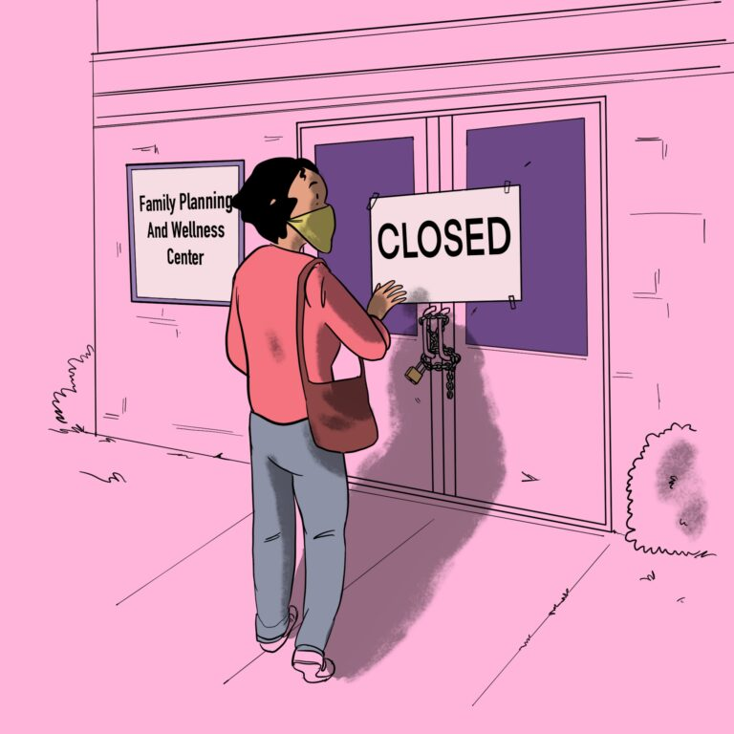
Context of SRH Care for Immigrants
Exclusions to public health insurance
Based on documentation status or years of U.S. residency
Limit access to essential SRH care
Publicly funded family planning providers are main source of primary care
Funding cuts threaten provision of SRH care

Slide 5
Context of SRH Care for Immigrants
Exclusionary migration policies and ongoing raids
Threaten safety
Impact access to public benefits
Limit care at country’s borders
Worsen inhumane conditions in detention

Slide 6
Context of SRH Care for Immigrants
Existing discriminatory and anti-immigrant environment
Systematic undermining of SRH needs and rights

Slide 7
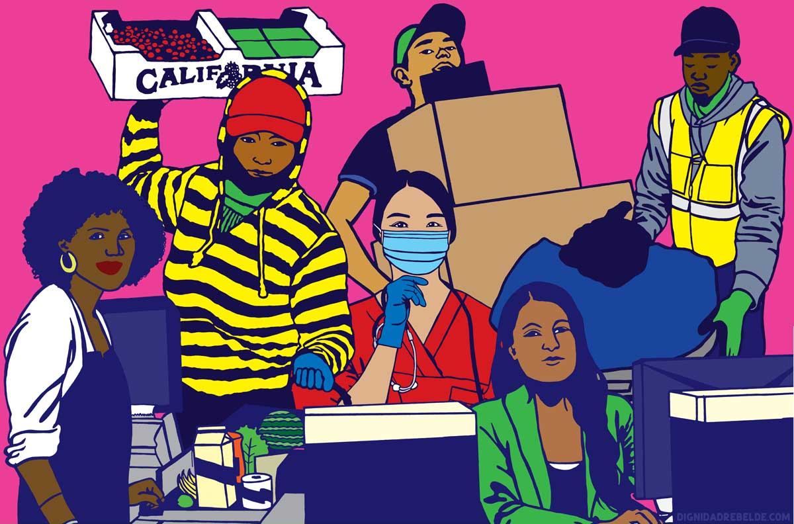
Responses to COVID-19 Magnify Barriers to SRH Care for Immigrants
Excluded from COVID-19 public health and economic relief
Essential workers in public health, agriculture, food prep, cleaning and maintenance
Half of workers in industries devastated by mass layoffs
Melanie Cervantes, Dignidad Rebelde

Slide 8
Responses to COVID-19 Magnify Barriers to SRH Care for Immigrants
Providers may be tapped for pandemic-related care
Possible disruption and diversion of SRH care
Pandemic exploited by politicians to threaten abortion access
Added obstacles to care on top of existing constraints

Slide 9
Responses to COVID-19 Magnify Barriers to SRH Care for Immigrants
Discriminatory health system
Immigration policies
Attacks on repro rights
Fewer opportunities to access and afford SRH care
COVID-19
response

Slide 10
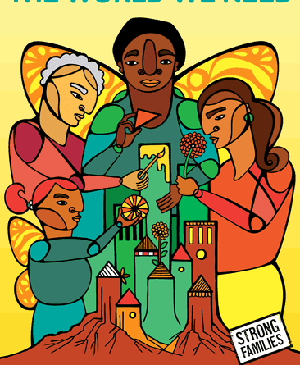
What Needs to Change?
Ensure that all immigrants are included in COVID-19 relief packages
SRH care must remain accessible to everyone
Enact Health Equity and Access under the Law for Immigrant Women and Families (HEAL) Act
Release all asylum seekers from detention
Fight exploitation of pandemic
Favianna Rodriguez, 2012: https://favianna.com/

