Slide 1
Adding It Up Investing in Contraception and Maternal and Newborn Health, 2017
Jacqueline E. Darroch, Elizabeth Sully and Ann Biddlecom
December 2017
Corrected December 2017

Slide 2
Objectives
Estimate the need among women in developing regions for:
Contraception to prevent unintended pregnancies
Pregnancy-related maternal and newborn care
Estimate the impact of meeting women’s needs for contraceptive and maternal and newborn care
Estimate the cost of fully meeting women’s needs for contraceptive and maternal and newborn care

Slide 3
Estimation approach
Present a comprehensive set of estimates for 2017 covering all developing regions
Base need and coverage estimates on World Health Organization (WHO) care recommendations and women’s reports in national surveys
Compare scenarios of coverage for needed care
Notes:
These estimates describe the current situation in 2017 for women of reproductive age in developing regions, spanning Asia, Africa and Latin America and the Caribbean (including more than 140 countries).
AIU compares different scenarios of coverage for needed care, focusing current levels of contraceptive, maternal and newborn health services and if there was 100% coverage of recommended services.
Impacted in measured in terms of lives saved and unintended pregnancies avoided and also the costs of current levels of care and what it takes to get to 100% coverage of recommended care.

Slide 4
Findings

Slide 5
Key findings
INVESTING IN SEXUAL AND REPRODUCTIVE HEALTH SAVES LIVES
214 million women in developing regions have an unmet need for modern contraception.
Meeting this unmet need would result in a 75% decline in unintended pregnancies, unplanned births and induced abortions.
Only 1 in 3 women experiencing complications during pregnancy or delivery receive the care they or their newborns need.
Providing full contraceptive and maternal and newborn care would reduce annual maternal deaths from 308,000 to 84,000 and newborn deaths from 2.7 million to 538,000.

Slide 6
Key findings
INVESTING IN SEXUAL AND REPRODUCTIVE HEALTH SAVES MONEY
Providing contraception and maternal and newborn care to all in need would cost $8.56 per person per year in developing regions.
Every additional $1 spent on contraceptive care saves $2.20 on maternal and newborn care because of declines in unintended pregnancies.

Slide 7
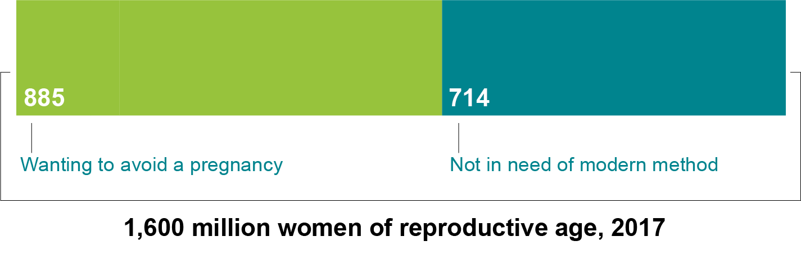
In developing regions, more than half of women of reproductive age want to avoid a pregnancy

Slide 8
But one-fourth of women in developing regions who want to avoid a pregnancy are not using modern contraceptives

Slide 9
Women in developing regions with unmet need for modern contraceptives account for 84% of unintended pregnancies

Slide 10
The number of women in developing regions with unmet need for modern contraception declined from 225 million in 2014 to 214 million in 2017
No. of women wanting to avoid pregnancy (millions)
Notes:
Despite the growing number of women who want to avoid a pregnancy, there has been a decline in the number of women in developing regions with unmet need from 225 million women in 2014 to 214 million women in 2017.
This decline is largely being driven by increases in modern contraceptive use.
The number of women in developing countries wanting to avoid pregnancy has grown over time due to population growth as well as more women and couples wanting smaller families.

Slide 11
Gaps persist across regions and country income levels in the proportion of contraceptive need met
% of women wanting to avoid a pregnancy who are using a modern contraceptive method

Slide 12
Large gaps persist across regions in the receipt of essential maternal health services
% among women giving birth
Notes:
Many women who give birth in developing regions do not receive essential maternal and newborn health care. There are also wide disparities in maternal and newborn health care across regions.

Slide 13
Fulfilling unmet need for modern contraceptive services in developing regions would reduce unintended pregnancies, births and abortions substantially
Millions
Notes:
If all unmet need for modern contraception were satisfied in developing regions, there would be approximately a three-quarters decline in unintended pregnancies, unplanned births, and induced abortions.

Slide 14
Fulfilling unmet need for modern contraceptive services and maternal health care in developing regions would save women’s lives
No. of maternal deaths
Notes:
Investing in both contraceptive and maternal care results in the largest declines in maternal mortality.
Under current levels of contraceptive and maternal health care, we still see about 308,000 maternal deaths in a year in developing regions.
If all women who needed it received recommended levels of maternal care, deaths due to pregnancy-related causes would drop dramatically to about 112,000.
If investments were made to meet not only maternal care needs but also full provision of contraceptive services to women who want to avoid pregnancy, maternal deaths would drop further to an estimated 84,000 each year—this last bar—from the 308,000 under current levels of care.

Slide 15
Expanding modern contraceptive services would help to offset the cost of improved maternal and newborn care in developing regions
2017 U.S. dollars (in billions)
Notes:
Investing in both contraceptive and maternal and newborn care not only saves lives, it saves costs.
Current levels of care in developing regions cost about $32 billion annually.
The middle bar shows what the cost would be if ONLY maternal and newborn health care were expanded to fully meet the needs of all pregnant women. This would cost $60.4 billion annually.
However, if we improve not only maternal and newborn care, but also fully meet women’s and couples’ contraceptive needs, we actually end up saving costs by preventing 67 million unintended pregnancies.
By spending an additional $5.7 billion on contraceptive care, we would end up saving $12.6 billion on maternal care – this gives us a net savings of $6.9 billion.

Slide 16
Investing in both contraceptive and maternal and newborn health services saves money
Notes:
Every additional dollar spent on contraceptive care in developing regions saves $2.20 on maternal and newborn care due to declines in unintended pregnancies.
Investing in contraceptive care is a cost-saving investment.

Slide 17
Notes:
NEXT SLIDE
In per capita terms, spending about $8.56 per person per year in developing regions on contraceptive, maternal and newborn health care would result in substantial impacts: from 67 million fewer unintended pregnancies to 224,000 fewer maternal deaths.

Slide 18
More than just access
Despite progress, gaps in meeting women’s needs still persist, especially among the poorest women and in the poorest countries
Barriers to care must be tackled, including:
Lack of trained health personnel
Poor quality services
Lack of outreach to marginalized groups of people
Social and economic factors

Slide 19
Need for greater investment
Governments, donors, NGOs, households and individuals all need to contribute to close the resource gaps
Critical investments are needed in both contraceptive and maternal and newborn care
Return on investment goes beyond impacts on health to broad social and economic benefits for women, their families and their societies

Slide 20
Acknowledgments
Findings and conclusions do not necessarily reflect
the positions and policies of the donors

Slide 21
More information
Fact sheet and supplemental tables available at:
www.guttmacher.org/fact-sheet/adding-it-up-contraception-mnh-2017

